Slide 1
Matrices: tables of numbers that also move vectors, and the core arithmetic of a neural-network layer
A language model has billions of parameters. What are those numbers, and what does the model do with them?
Mathematics for AI and Machine Learning | Session 3 of 18 | Linear algebra
KLAi Professional Learning | Jotham Martin Wambi
Notes:
Welcome back. Last session we met vectors, and measured how alike two of them are. Today we stack vectors into a matrix. A matrix is a table of numbers, and it is also a machine that moves points. By the end you will know exactly what people mean when they say a model has billions of parameters.
The question for today is this: A language model has billions of parameters. What are those numbers, and what does the model do with them? Keep it in mind. At the end of the session we come back to it and see how much more you can say.

Slide 2



Today in one view: what you will leave with
By the end of today you can
Read a matrix as a table and as a transformation, and state its shape (rows by columns)
Multiply a matrix by a vector and a matrix by a matrix by hand, and say when the shapes allow it
Compute a layer y = W x + b, and count the parameters of a small network, in Python and in a spreadsheet
Notes:
By the end of today you can read a matrix as a table of numbers and as a transformation that moves points, and you can state its shape. You can multiply a matrix by a vector and a matrix by a matrix by hand, and say when the shapes allow it.
And you can compute one layer of a neural network, y equals W x plus b, and count its parameters. That last step shows what billions of parameters means.

Slide 3
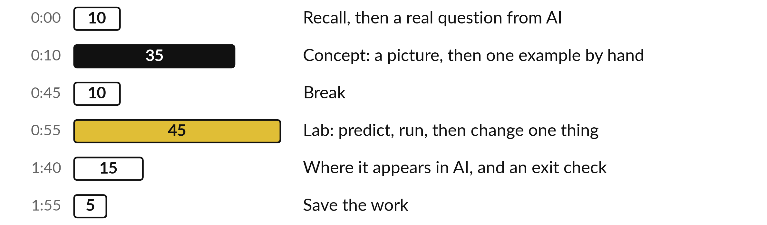
Your two hours: matrices,
then the lab, then parameters
Pictures and hand calculations first. Then the lab on products, layers and parameters.
Notes:
The first ten minutes recall Session 2 and pose today question about billions of parameters. Then thirty-five minutes of ideas, each with a picture and a small calculation by hand, a break, and a forty-five minute lab in Python or in a spreadsheet. The last fifteen minutes show where matrices appear in language models, and give you an exit check. Then you save your work.

Slide 4
Three questions from last time
1. What is the dot product of (1, 2, 3) and (4, 0, 2)? Is the result a vector or a number?
2. What is the L2 norm (length) of the vector (2, 3, 6)?
3. Why does a search tool rank by cosine similarity and not by the raw dot product?
Answer aloud first. Then we check together.
Notes:
Three quick questions from Session 2. Answer aloud first, and then we check together. It is a warm-up to bring last time back.
Question one. What is the dot product of (1, 2, 3) and (4, 0, 2)? Is the result a vector or a number? Take a moment.
A good answer is this. 10. It is one number: 1 × 4 + 2 × 0 + 3 × 2.
Question two. What is the L2 norm (length) of the vector (2, 3, 6)? Say it to yourself first.
A good answer is this. 7, because 4 + 9 + 36 = 49 and the square root of 49 is 7.
Question three. Why does a search tool rank by cosine similarity and not by the raw dot product? Think about your own task as you answer.
A good answer is this. Cosine similarity divides by both lengths, so a long vector does not win just for being long. Only the direction counts.
If an answer was missing, do not worry. Your notes from last class have it. Now to today.

Slide 5
Answers to the three questions from Session 2
Question | Short answer
What is the dot product of (1, 2, 3) and (4, 0, 2)? Is the result a vector or a number? | 10. It is one number: 1 × 4 + 2 × 0 + 3 × 2.
What is the L2 norm (length) of the vector (2, 3, 6)? | 7, because 4 + 9 + 36 = 49 and the square root of 49 is 7.
Why does a search tool rank by cosine similarity and not by the raw dot product? | Cosine similarity divides by both lengths, so a long vector does not win just for being long. Only the direction counts.
If one answer surprised you, look again at the Session 2 slides before the lab.
Notes:
The short answers. First, the dot product of one two three with four zero two is ten, a single number: one times four, plus two times zero, plus three times two. Second, the L2 norm of two, three, six is seven, because four plus nine plus thirty-six is forty-nine.
Third, search tools rank by cosine similarity because it divides by both lengths, so a long vector does not win just for being long. Only the direction counts. Today every entry of a matrix product is one of these dot products.

Slide 6


Words we use today
Word | What it means
Matrix | A table of numbers with m rows and n columns. Its shape is m × n.
Matrix multiplication | A rule that combines two matrices. Each entry of the answer is a dot product of a row and a column.
Transpose | The matrix flipped so that rows become columns. It is written with a small T.
Identity matrix | A square matrix of 1s on the diagonal and 0s elsewhere. It leaves every vector unchanged.
Parameters | The numbers inside a model that training sets: its weights W and biases b.
Notes:
Five words for today. I give the plain meaning of each, and we use every one of them before the end of the session.
Matrix. A table of numbers with m rows and n columns. Its shape is m × n.
Matrix multiplication. A rule that combines two matrices. Each entry of the answer is a dot product of a row and a column.
Transpose. The matrix flipped so that rows become columns. It is written with a small T.
Identity matrix. A square matrix of 1s on the diagonal and 0s elsewhere. It leaves every vector unchanged.
Parameters. The numbers inside a model that training sets: its weights W and biases b.

Slide 7
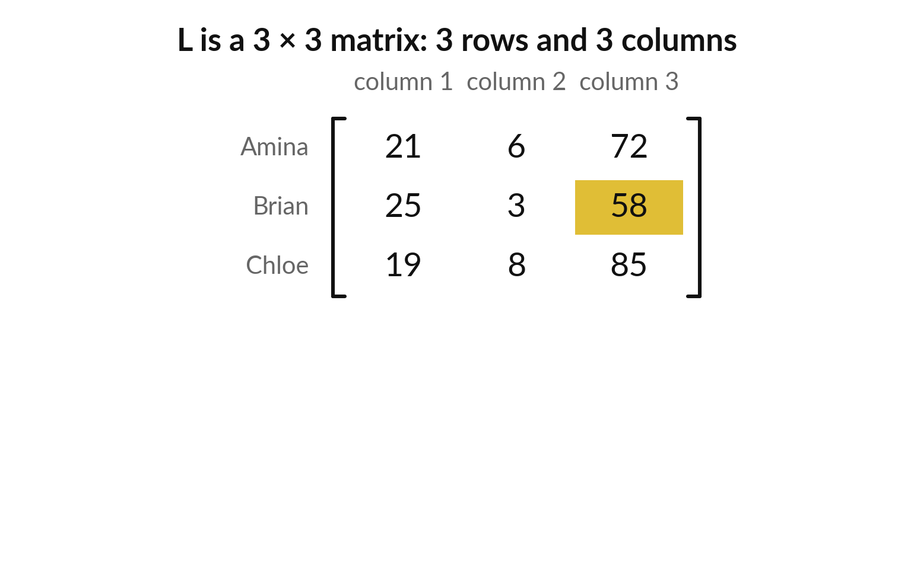
A matrix is a table of numbers
with rows and columns
Matrix: a table of numbers. Here L holds three learners from Session 2, one per row: age, hours, score.
Each row is a vector: Amina = (21, 6, 72).
Gold entry: row 2, column 3 is 58, Brian's score.
Illustrative (made-up numbers to show the arithmetic).
Notes:
A matrix is a table of numbers. This one, called L for learners, holds the three learners from last session, with age, hours studied per week and quiz score. These numbers are made up. Each row is a vector, so a matrix is also a stack of vectors.
Each column holds one kind of measurement. The gold entry is in row two and column three, and it is fifty-eight, the score of Brian. Always say the row first, then the column. What is the entry in row three and column one?

Slide 8
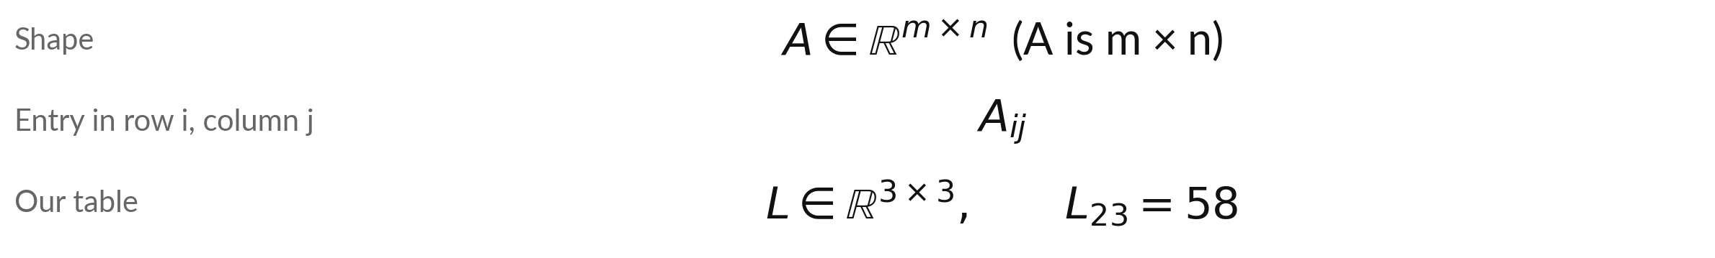
A capital letter names the matrix, and
two small numbers pick one entry
Symbol | What it means | In our data
A, L | A matrix is written with a capital letter. A vector is a lowercase bold letter. | L = the learner table
m × n | The shape: m rows by n columns. Rows are always named first. | 3 × 3
∈ and ℝ | ∈ reads "is a". ℝ is the real numbers: ordinary numbers with decimals. | L is a 3 × 3 table of real numbers
Aᵢⱼ | The entry in row i, column j of A (small i and j below the A). | L₂₃ = 58
Python counts from 0, so L₂₃ has row index 1 and column index 2. A spreadsheet counts from 1: INDEX(range, 2, 3).
Notes:
Matrix notation has three parts. A matrix has a capital letter, such as A. Its shape is written m by n, which means m rows and n columns, and the rows come first. Papers write the shape with two symbols you will meet often. The curly e reads is a, and the double-struck R means the real numbers, the ordinary numbers with decimals.
An entry has the row number first and the column number second, so L two three is fifty-eight. Watch out in Python: it counts from zero, so the same entry has row index one and column index two. A spreadsheet counts from one.

Slide 9
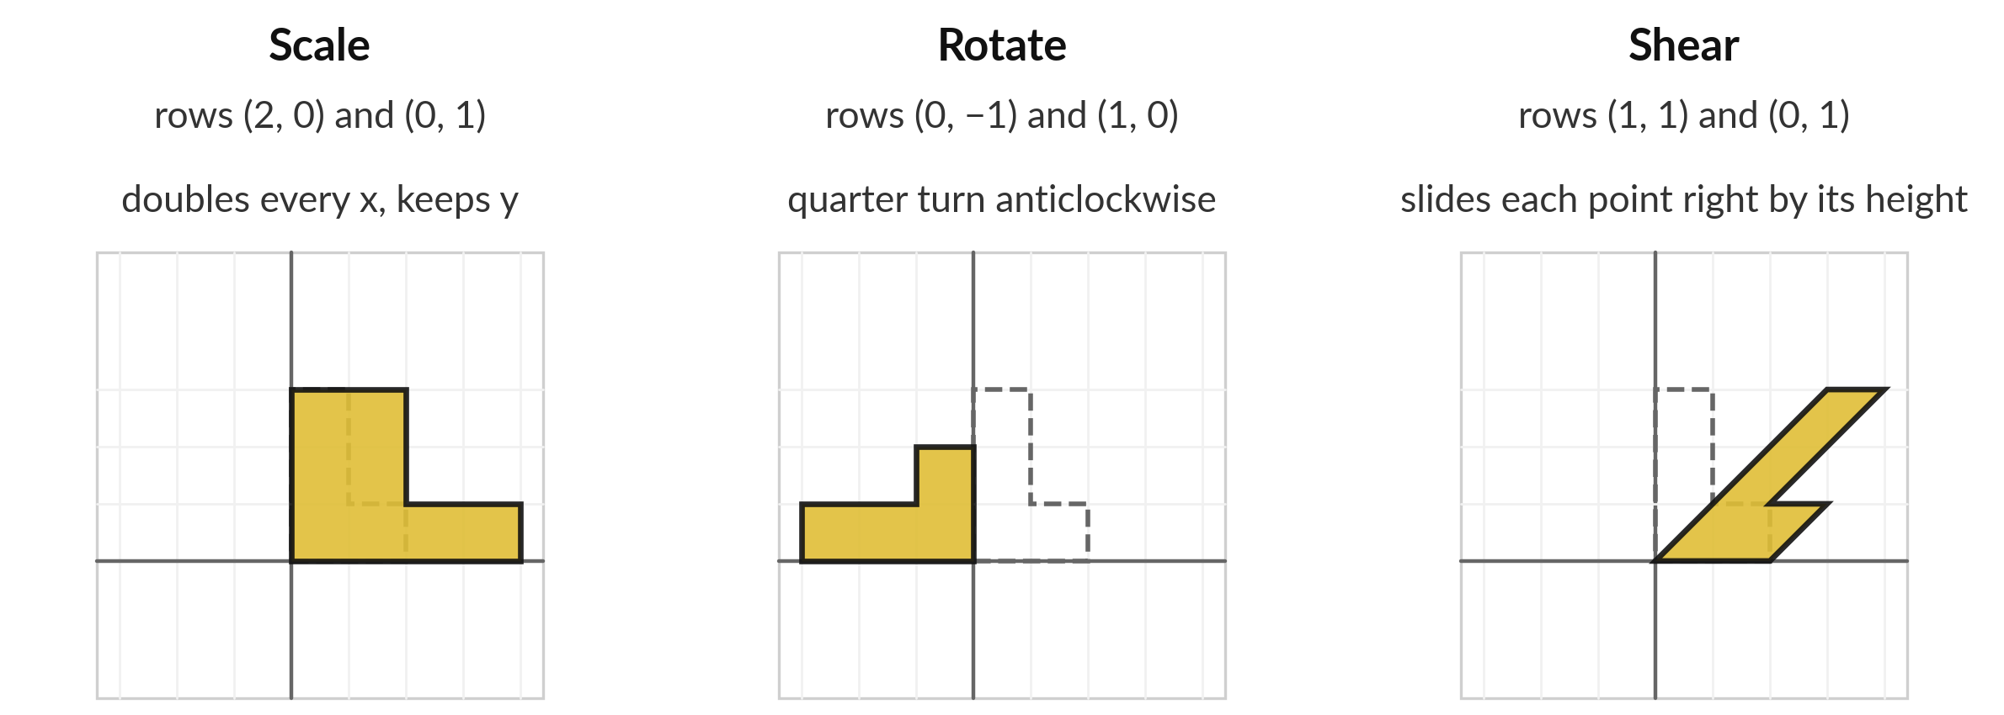
A matrix can also move points:
scaling, rotating and shearing a shape
Grey dashed: the original shape. Gold: the result. The rotation sends the corner (1, 3) to (−3, 1).
Notes:
A matrix has a second life. It can move every point of a drawing. The dashed grey shape is an L-shaped drawing. In the first panel the matrix with rows two zero and zero one doubles every x value and keeps y. In the second panel the matrix with rows zero minus one and one zero turns the whole shape a quarter turn anticlockwise, so the corner one, three goes to minus three, one.
In the third, the matrix with rows one one and zero one shears the shape, which slides each point right by its height. In each case the matrix is a small table of four numbers. A transformation is a rule that moves every point. Which one keeps the shape exactly as it was, only turned?
The scale also doubles the area, and Session 4 returns to that.

Slide 10
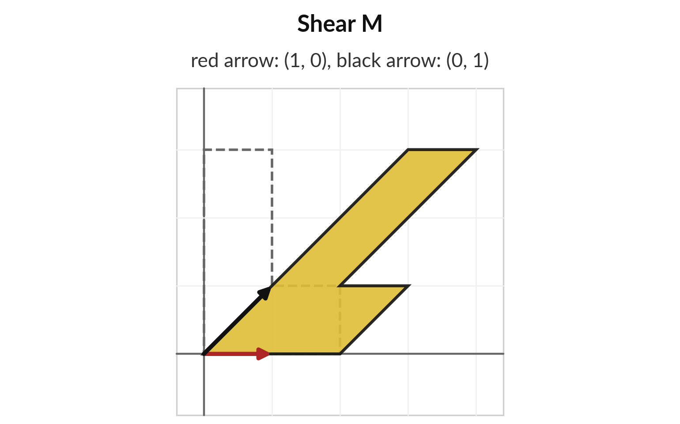
The columns of a matrix show
where the two axis arrows land
M has rows (1, 1) and (0, 1). Red arrow (1, 0) lands on (1, 0). Black arrow (0, 1) lands on (1, 1). These two are the columns of M.
Every other point follows: the grid tilts.
Corner (1, 3) lands on (4, 3). The next two slides show the rule and the working.
To read a transformation, read the columns.
Notes:
The columns give a quick way to read a transformation. Take the shear matrix with rows one one and zero one. The red arrow pointing along x lands on the first column of the matrix, one zero. The black arrow pointing along y lands on the second column, one one.
Because a matrix treats the grid evenly, every other point follows these two arrows, and the whole grid is tilted. So to see what a matrix does, look at its columns. The corner at one, three of our shape lands on four, three. The calculation comes next.

Slide 11
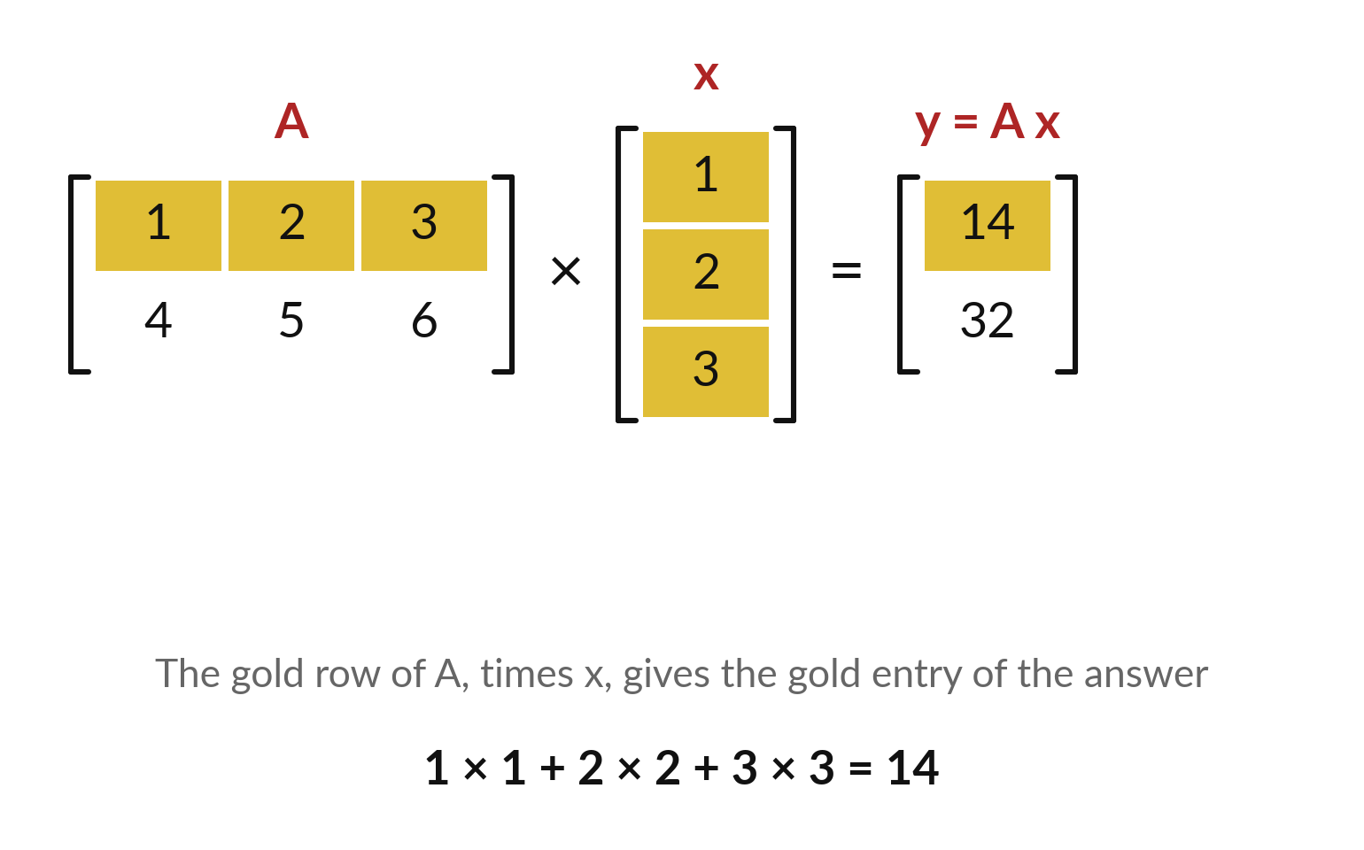
Matrix times vector: each entry of the answer
is a dot product of one row with the vector
Multiply A (2 × 3) by x (3 entries). Dot each row of A with x in turn.
Row 1: 1 × 1 + 2 × 2 + 3 × 3 = 14, the gold entry.
Row 2: 4 × 1 + 5 × 2 + 6 × 3 = 32.
The answer y = (14, 32) has one entry per row of A.
Notes:
Multiplication comes next. A matrix times a vector is built from dot products, which you know from Session 2. Take the first row of A, one two three, and the vector x, one two three. Multiply matching entries and add: one, plus four, plus nine, which is fourteen.
That is the first entry of the answer. The second row, four five six, gives four plus ten plus eighteen, which is thirty-two. So the answer is the vector fourteen, thirty-two, with one entry for every row of A. A third row in A would add a third entry to the answer.

Slide 12
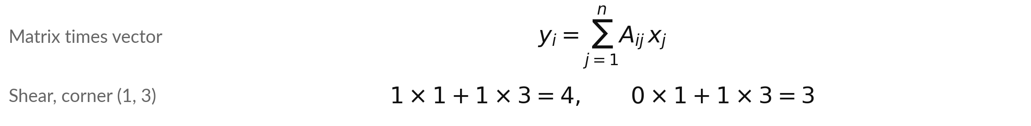
Matrix times vector as a formula, and the
same calculation for a point of the shape
Symbol | What it means | In our data
Aᵢⱼ | Entry in row i, column j of A. | A₁₂ = 2
xⱼ | Entry j of the vector x. It meets column j of A. | x₂ = 2
yᵢ | Entry i of the answer: the dot product of row i of A with x. | y₁ = 14
Σ, j, n | Add up over j = 1 to n, the columns of A. | n = 3
Shear on (1, 3) | Row 1 of M with (1, 3), then row 2 of M with (1, 3). | The point (1, 3) lands on (4, 3)
Python: A @ x. Spreadsheet: =MMULT(A, x) as an array formula.
Notes:
As a formula, the entry i of the answer is the sum, over j, of the entry in row i and column j of A, times entry j of x. That is the dot product of row i with x. We can use it on the shear matrix.
The corner one, three of our shape: row one of M is one, one, and gives one times one plus one times three, which is four. Row two is zero, one, and gives three. So the point lands on four, three. In Python you write A at x. In a spreadsheet you write MMULT as an array formula.

Slide 13
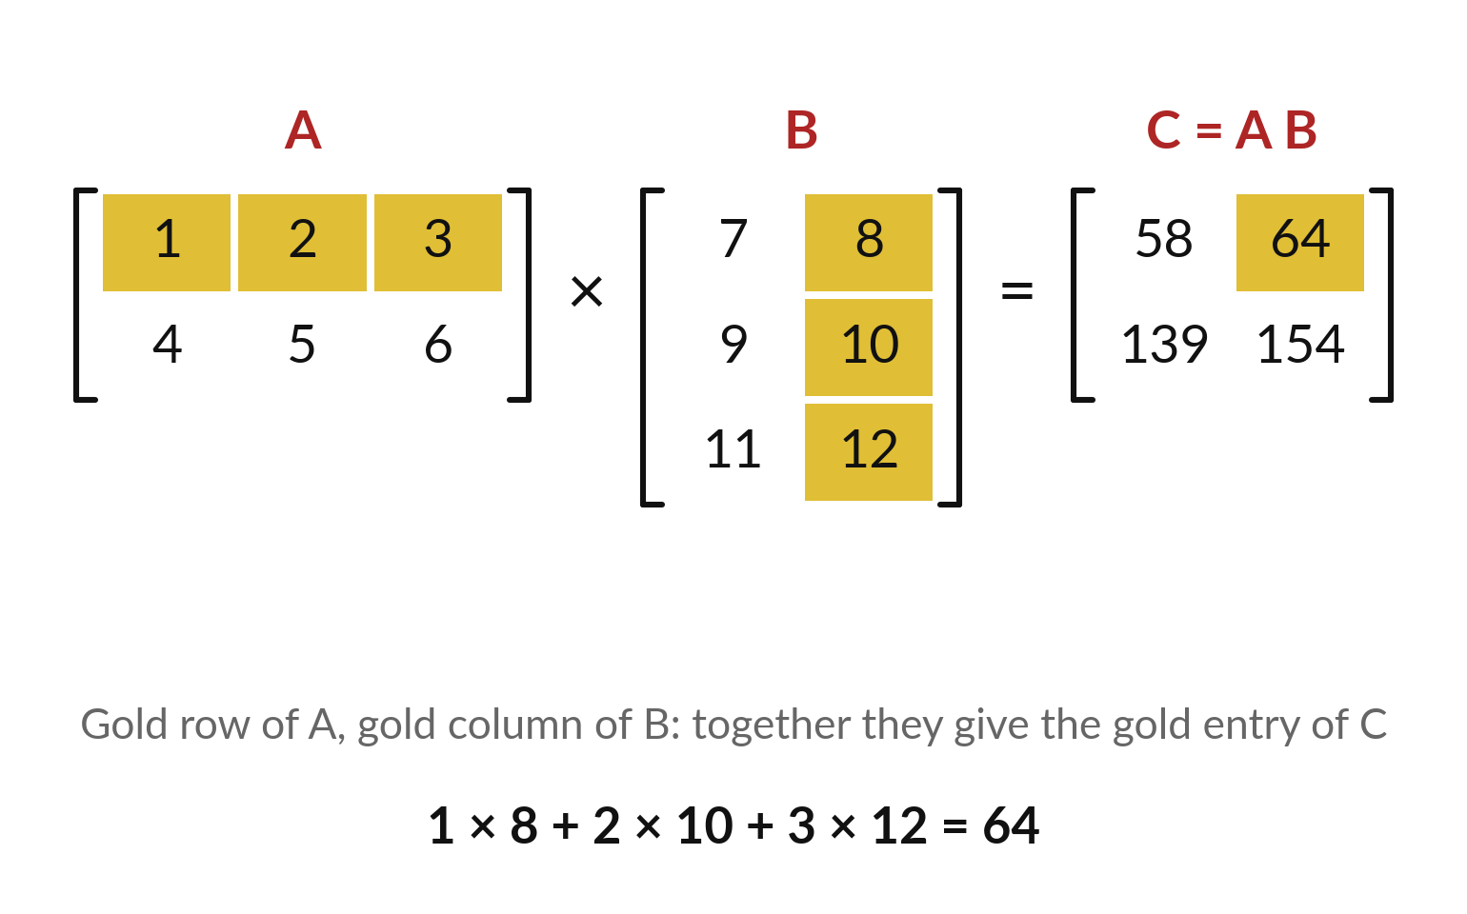
Matrix times matrix: each entry of the answer is
a dot product of a row of A with a column of B
Multiply A (2 × 3) by B (3 × 2). Entry (i, k) of the answer is row i of A dotted with column k of B.
Gold: row 1 of A, column 2 of B: 8 + 20 + 36 = 64.
C = A B has rows (58, 64) and (139, 154).
C has the rows of A and the columns of B: 2 × 2.
Notes:
Multiplying two matrices repeats the same idea. Every entry of the answer is a dot product of one row of A with one column of B. The gold entry sits in row one and column two, so we take row one of A, which is one two three, and column two of B, which is eight, ten, twelve.
One times eight, plus two times ten, plus three times twelve, is eight plus twenty plus thirty-six, which is sixty-four. Do the same for the other three entries and you get fifty-eight, sixty-four, one hundred thirty-nine, one hundred fifty-four. The answer has the rows of A and the columns of B. Row two with column one gives one hundred thirty-nine.

Slide 14

The matrix product as a formula,
with a count of the multiplications
Symbol | What it means | In our data
A, B, C | A is m × n, B is n × p. Then C = A B is m × p. | C is 2 × 2
Σ, j, n | Add up over j = 1 to n. | j = 1, 2, 3
Cᵢₖ | Row i of A dotted with column k of B. | C₁₂ = 64
Cost | m × p entries, n multiplications each. | 2 × 3 × 2 = 12
Python: A @ B. Spreadsheet: =MMULT(A, B) over a 2 × 2 range, entered as an array formula.
Notes:
The matrix product as a formula: the entry in row i and column k is the sum over j of A i j times B j k. The index j runs along the row of A and down the column of B, and it disappears in the sum.
Our entry C one two is sixty-four. We can count the work too. C has m times p entries, and each entry needs n multiplications, so the total is m times n times p. For our small case that is 12 multiplications. Remember this count, because it grows fast, and it explains why computers for AI are built the way they are.

Slide 15
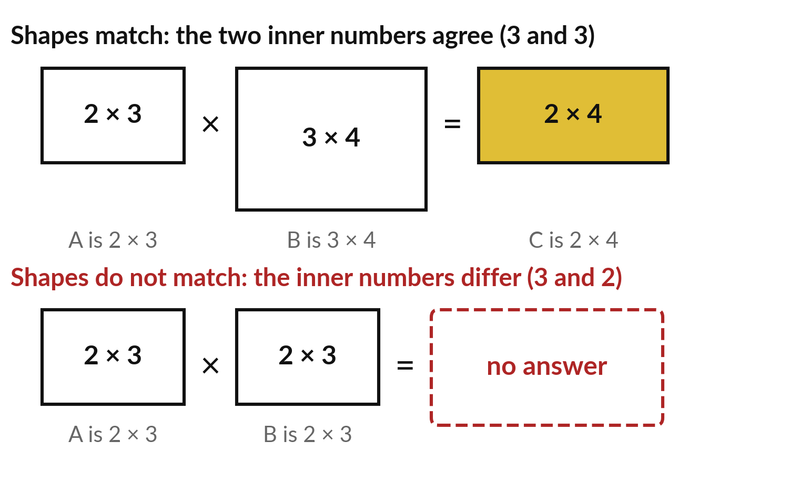
Shapes must match: inner numbers agree,
outer numbers give the answer's shape
A (m × n) times B (n × p) works when the columns of A equal the rows of B. The answer is m × p.
2 × 3 times 3 × 4 works: inner 3 and 3. The answer is 2 × 4.
2 × 3 times 2 × 3 fails: a row has 3 entries, a column 2.
Check the shapes first.
Notes:
Not every pair of matrices can be multiplied. Each entry is a dot product of a row of A with a column of B, and a dot product needs two vectors of the same length. So the number of columns of A must equal the number of rows of B.
In the top picture, two by three times three by four works, because the inner numbers are both three. The answer takes the outer numbers, two by four. In the bottom picture the inner numbers are three and two, so a row of three entries meets a column of two entries, and there is no answer.
Would three by two times three by two work?

Slide 16
The order matters: A B and
B A are different matrices
A B
B A
A 2 × 3, B 3 × 2.
A B is 2 × 2, rows (58, 64) and (139, 154).
Works: inner 3 and 3.
B 3 × 2, A 2 × 3.
B A is 3 × 3, first row (39, 54, 69).
Works: inner 2 and 2.
The order matters: A B is usually different from B A.
Notes:
With ordinary numbers, three times five equals five times three. Matrices do not behave that way. Here A times B is two by two, with entries fifty-eight, sixty-four, one thirty-nine, one fifty-four. But B times A is three by three, starting with the row 39, 54, 69. Different shape, different numbers.
Sometimes B times A is not possible at all. So in a formula, the order of the matrices is part of the meaning. In a neural network the order is the order of the layers.

Slide 17
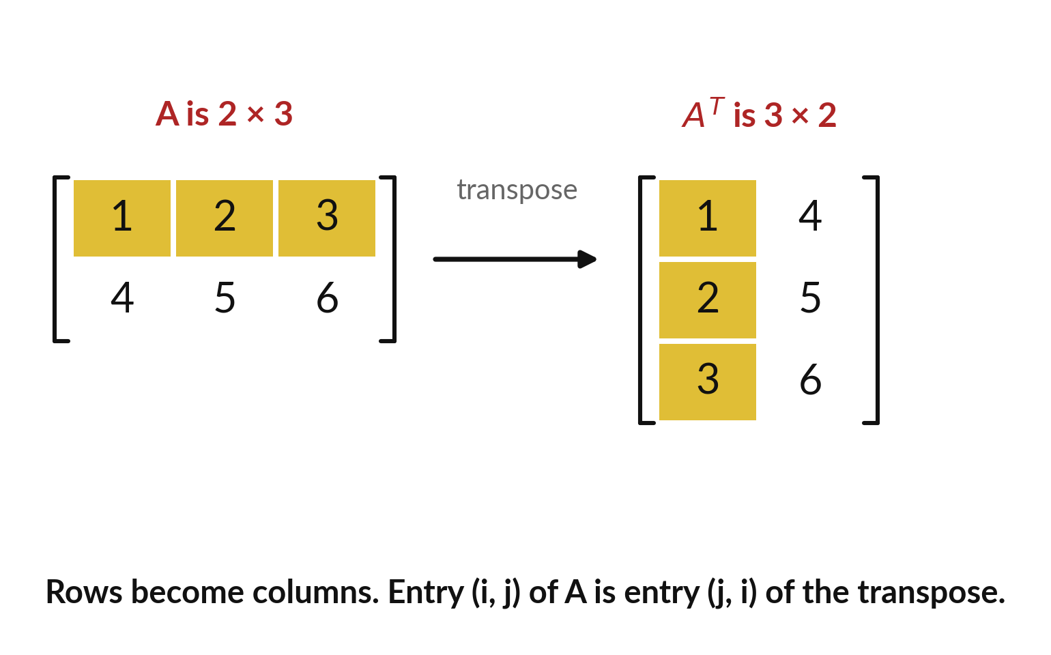
The transpose flips rows into columns
Transpose: write each row of A as a column. The result is written Aᵀ, with a small T.
A is 2 × 3, so Aᵀ is 3 × 2.
Entry (i, j) of A becomes entry (j, i).
Dot product: u · v equals uᵀ v.
Notes:
The transpose flips a matrix so that rows become columns. Our A has two rows and three columns. Its transpose has three rows and two columns. The first row of A, one two three, becomes the first column of A transpose. In terms of entries, the entry in row i and column j moves to row j and column i.
You will see the small T everywhere in machine learning papers. For example, the dot product of two vectors u and v is the product of u transpose, a row, with v, a column. The transpose of a three by three matrix such as our learner table is again three by three, with the rows and columns swapped.

Slide 18
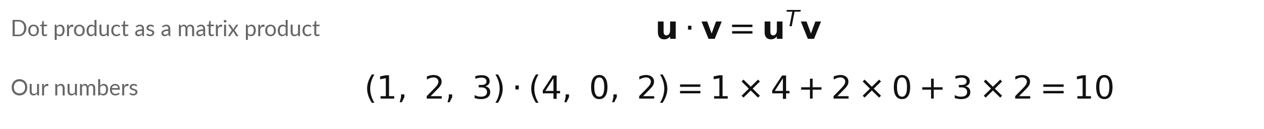
The dot product is a matrix
product of a row and a column
Symbol | What it means | In our data
uᵀ | The transpose of u: a row of 3 numbers, a 1 × 3 matrix. | (1, 2, 3)
v | A column of 3 numbers, a 3 × 1 matrix. | (4, 0, 2)
uᵀ v | Shapes: 1 × 3 times 3 × 1. The inner numbers match and the answer is 1 × 1: one number. | 10
From now on a vector stands as a column; on paper we still write (1, 2, 3) across to save space. A row is written uᵀ.
Notes:
From today a vector stands as a column, a matrix with one column. On paper I still write it across the page to save space, as in Session 2, and when I mean a row I write the transpose, u with a small T. The dot product of u and v is the matrix product of u transpose and v.
Check the shapes: one by three, times three by one. The inner numbers match, and the answer is one by one, which is a single number. With one, two, three and four, zero, two we get ten, as at the start of the session. So a matrix product is a whole table of dot products, computed at once.

Slide 19
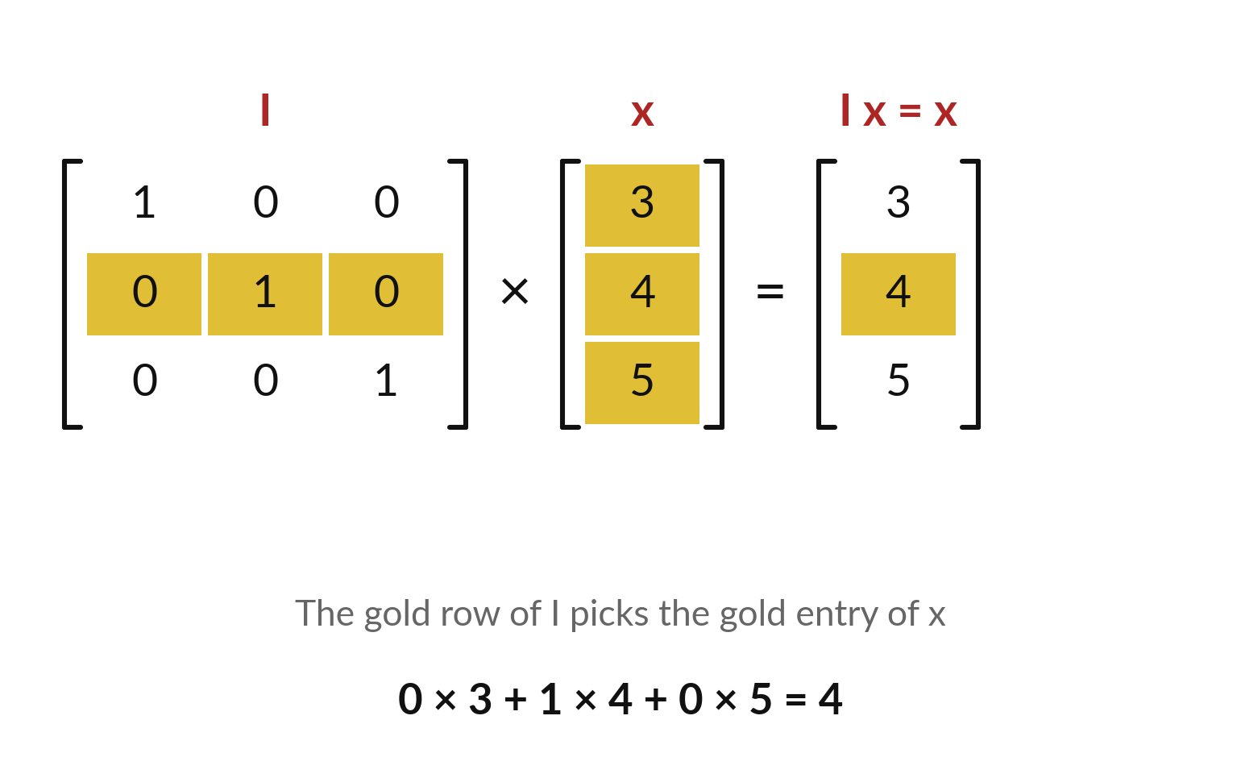
The identity matrix leaves
every vector unchanged
Identity matrix I: 1s on the diagonal, 0s everywhere else. For any vector x, I x = x.
Each row of I picks one entry of x. Row 2 picks 4.
It is the matrix version of multiplying by 1.
Session 4 uses it to define the inverse.
Notes:
The identity matrix has ones on the diagonal and zeros everywhere else. Multiply it by any vector and you get the same vector back. In the picture, row two of the identity is zero, one, zero. Its dot product with three, four, five is zero plus four plus zero, which is four, the second entry.
Each row picks out one entry. It is the matrix version of multiplying a number by one. It matters in Session 4, where the inverse of a matrix is the matrix that gives the identity when you multiply by it.

Slide 20
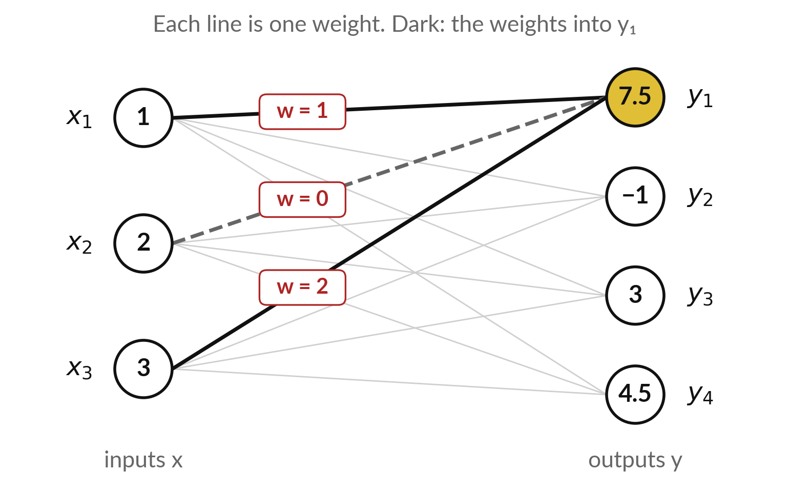
A linear layer computes y = W x + b; real
layers then apply an activation function
A neural network is a chain of layers. This layer turns 3 inputs x into 4 outputs y. W is the weight matrix (4 × 3), b the bias vector.
Illustrative: x = (1, 2, 3).
Output 1 (dark lines): 1 × 1 + 0 × 2 + 2 × 3 = 7, plus bias 0.5 gives 7.5. The weight from x₂ is 0 (dashed).
Training sets W and b: the parameters.
Notes:
This is the most important use of a matrix in AI. A neural network is a chain of layers, and one linear layer turns a vector x of inputs into a vector y of outputs. The rule is y equals W x plus b. W is a matrix of weights, one weight on every line in the picture, and b is a vector of biases, one for each output.
Our numbers are illustrative: x is one, two, three. The dark lines are row one of W. Its weights one, zero and two give one plus zero plus six, which is seven. Add the bias, zero point five, and the first output is seven point five. The values of W and b are what training sets, so they are the parameters.
A real layer then also applies an activation function, which we meet in Session eleven.

Slide 21
The layer y = W x + b, with every
symbol named and worked in full
Symbol | What it means | In our data
x | The input vector, 3 entries. | (1, 2, 3)
W | The weight matrix, 4 × 3: 4 outputs, 3 inputs. | rows (1, 0, 2), (0, 1, −1), (2, 1, 0), (−1, 1, 1)
W x | Four dot products: 7, −1, 4 and 4. | (7, −1, 4, 4)
b | The bias vector. It is added entry by entry. | (0.5, 0, −1, 0.5)
y | The output: W x + b. | (7.5, −1, 3, 4.5)
A real layer then applies an activation function to each output (Session 11). Python: W @ x + b.
Notes:
Every symbol of the layer, named. x has three entries. W is four by three, and the shapes match, because the inner numbers are three and three. W times x is four dot products, giving seven, minus one, four and four. Then we add the bias b entry by entry: zero point five, zero, minus one and zero point five.
The output y is seven point five, minus one, three and four point five. The shape rule gave us the shape of y before we calculated anything: four by three times three gives four. A real layer then adds one more step, an activation function, which we meet in Session eleven.

Slide 22
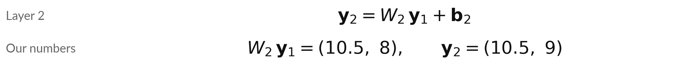
Layer 2 takes the 4 outputs of layer 1 as its inputs
Symbol | What it means | In our data
y₁ | The output of layer 1, which is the input of layer 2. | (7.5, −1, 3, 4.5)
W₂ | The weight matrix of layer 2, 2 × 4. | rows (1, 0, 1, 0) and (0, 1, 0, 2)
b₂ | The bias vector of layer 2, 2 entries. | (0, 1)
y₂ | The output of layer 2: W₂ y₁ + b₂. | (10.5, 9)
Activation: a nonlinear function (graph not a straight line, e.g. max(0, x)) on each output (Session 11).
Notes:
A second layer follows. Its input is the output of the first layer, the four numbers seven point five, minus one, three and four point five. Its weight matrix W two has two rows and four columns: one, zero, one, zero, and zero, one, zero, two. The first dot product gives seven point five plus three, which is ten point five.
The second gives minus one plus nine, which is eight. Add the bias b two, zero and one, and the output is ten point five and nine. An activation function is a fixed nonlinear function that a real layer applies to each output. Nonlinear means its graph is not a straight line: max of zero and x, for example, turns every negative number into zero. We meet it in Session eleven.

Slide 23
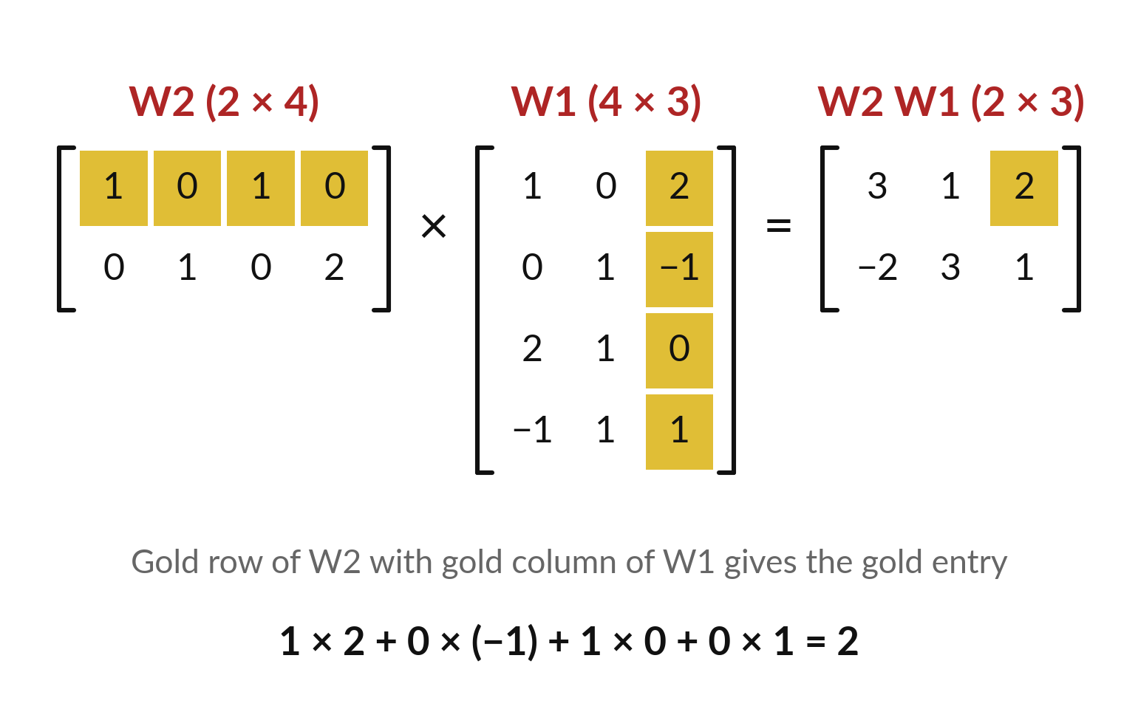
Stacking two layers is a matrix times a matrix
With no biases, layer 2 after layer 1 is W2 (W1 x) = (W2 W1) x. Multiply the weights first.
W2 W1 is 2 × 3: rows (3, 1, 2) and (−2, 3, 1).
On x = (1, 2, 3) it gives (11, 7), as two layers in turn do.
With no activation function (nonlinear step), two layers collapse into one.
Notes:
Real models have many layers one after another. Take a second layer W2 that turns four numbers into two. Skip the biases for a moment. Feeding x into layer one and the result into layer two is the same as multiplying W2 by W1 first, and then by x.
W2 is two by four and W1 is four by three, so the product is two by three. Applied to x, it gives 11 and 7, exactly the same as doing the two layers in turn. That also shows why real networks add an activation function between the layers. Without it, a hundred layers would collapse into a single matrix.

Slide 24
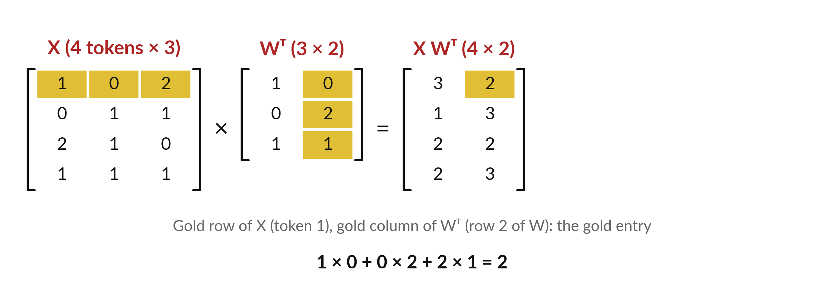
A whole sentence goes through a layer at
once: tokens as rows, so the layer is X Wᵀ
Illustrative. W is 2 outputs × 3 inputs. Tokens as rows: X Wᵀ (as in PyTorch).
Notes:
A token is a piece of text, often a word or part of a word, and each token has a vector, its embedding from Session 2. Stack four token vectors as the rows of a matrix X, four by three. These numbers are illustrative. The layer W turns three inputs into two outputs, so it is two by three.
For one column vector x we computed W x. With a token in each row, the shapes force a change: four by three times two by three does not work, but four by three times W transpose, three by two, does. Each row of X W transpose is W x for one token, written as a row.
The gold entry is two. Libraries such as PyTorch store W as outputs by inputs and compute exactly X W transpose.

Slide 25
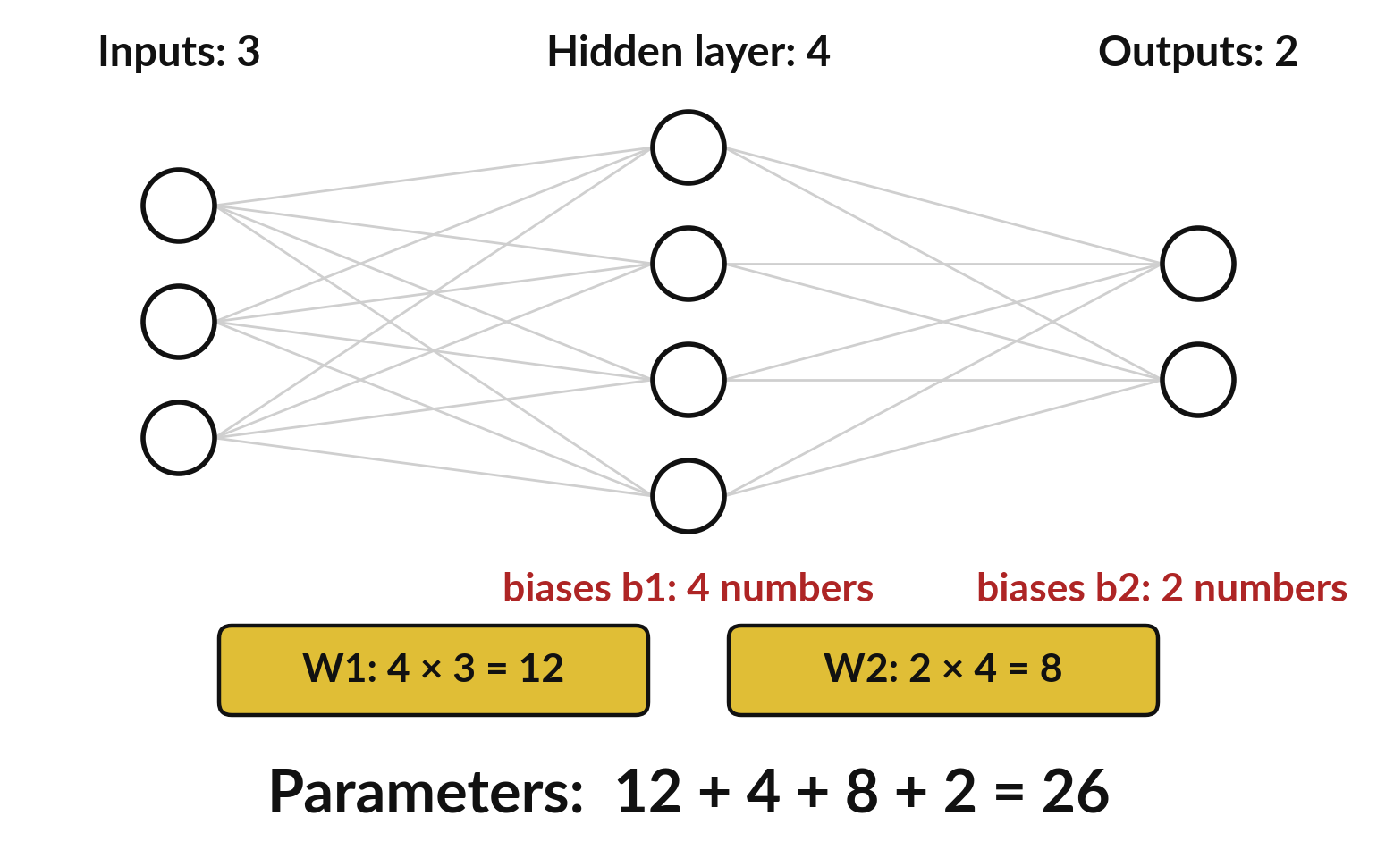
Counting the numbers in the matrices
gives the parameters of a small network
Parameters: the numbers a model learns. Toy network: 3 inputs, a hidden layer of 4 (between input and output), 2 outputs.
Layer 1: W1 is 4 × 3 = 12 weights, plus 4 biases.
Layer 2: W2 is 2 × 4 = 8 weights, plus 2 biases.
Total: 12 + 4 + 8 + 2 = 26 parameters.
Notes:
Counting comes next. Take a toy network with three inputs, a hidden layer of four numbers and two outputs. The first layer has a four by three weight matrix, which is twelve numbers, and four biases. The second layer has a two by four weight matrix, which is eight numbers, and two biases.
Add them up: twelve, plus four, plus eight, plus two, is twenty-six. Those twenty-six numbers are the parameters of this toy model. Training will set each of them. What would change if the hidden layer had five numbers instead of four?

Slide 26
Parameters of a layer: m × n weights plus m biases
Symbol | What it means | In our data
n | Number of inputs of the layer, which is the number of columns of W. | layer 1: n = 3
m | Number of outputs, which is the number of rows of W and the length of b. | layer 1: m = 4
m × n | The weights in W. | 12
+ m | The biases in b. | 4
Bigger | A layer from 1,000 inputs to 1,000 outputs. | 1,000 × 1,000 + 1,000 = 1,001,000
Python: W.size + b.size. Spreadsheet: ROWS(W) * COLUMNS(W) + ROWS(b).
Notes:
The rule has two parts. A layer with n inputs and m outputs has a weight matrix with m rows and n columns, so m times n weights, and m biases. In total, m times n plus m. Layer one of the toy network has four times three plus four, which is sixteen.
Layer two has two times four plus two, which is ten. Sixteen plus ten is twenty-six. Now scale up. One layer from a thousand inputs to a thousand outputs already has 1,001,000 parameters, more than a million, in just one layer. That is how the numbers climb so fast.

Slide 27
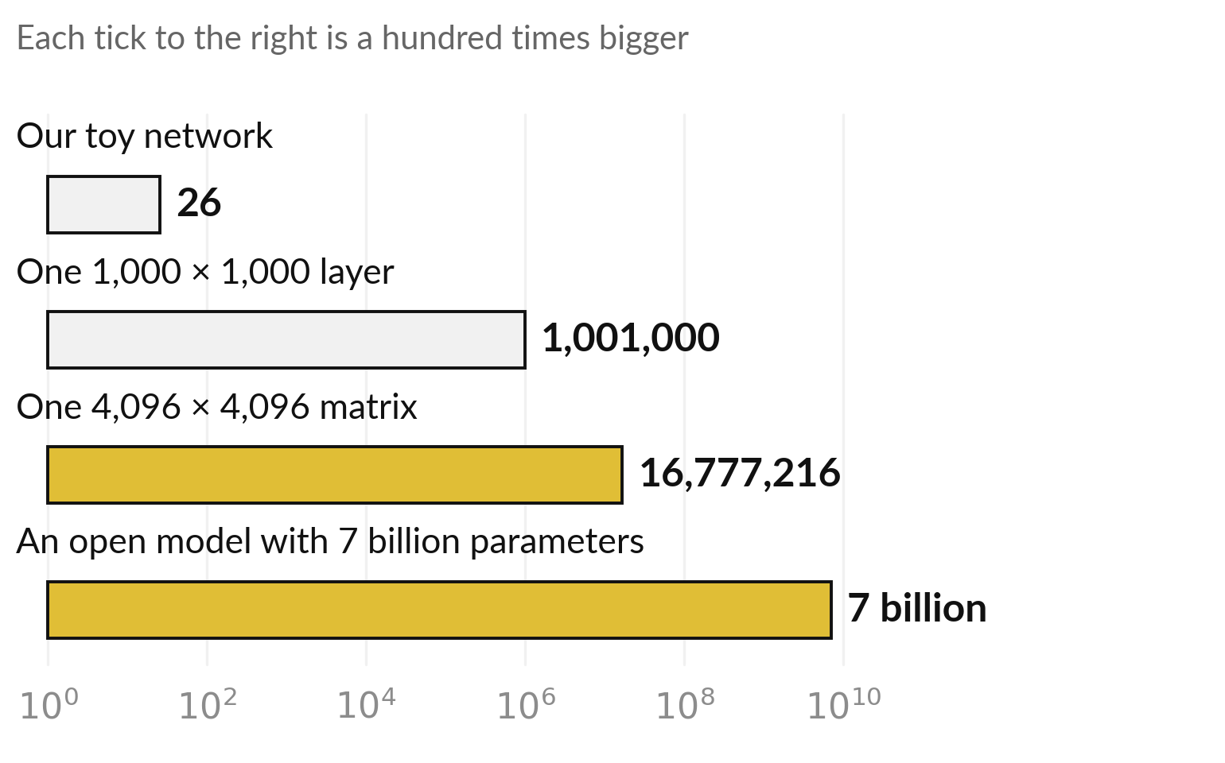
Billions of parameters means billions
of numbers in matrices like these
Open models publish their size: Llama 2 has 7, 13 and 70 billion parameters (Touvron et al., 2023).
Logarithmic scale, as in Session 1.
A byte is 8 bits. A 16-bit number takes 2 bytes, so 7 billion numbers fill 14 gigabytes.
Training sets every one.
Notes:
How big is big?
The bars use a logarithmic scale, like the logarithms in Session one: each tick to the right is a hundred times bigger. Our toy network has twenty-six parameters. One layer from a thousand to a thousand has just over a million. A single weight matrix of four thousand ninety-six by four thousand ninety-six has 16,777,216 numbers, and open models use matrices of this kind of size.
Open models also publish their total size. The Llama 2 models come in 7, 13 and 70 billion parameters. A byte is eight bits. If each number is stored in sixteen bits, which is two bytes, seven billion numbers need 14 gigabytes. The sizes of closed models are not published, so I will not quote them.

Slide 28


Common mistake: multiplying two matrices
entry by entry instead of row by column
Wrong
Right
Multiply matching entries of A and B.
Python: A * B, entry by entry. For our 2 × 3 and 3 × 2 it fails.
Dot products of rows of A with columns of B.
Python: A @ B. Spreadsheet: MMULT.
Check the shapes first.
The star (*) multiplies entry by entry. The at sign (@) gives the matrix product.
Notes:
A common mistake is to multiply two matrices entry by entry. That is a different operation, called the elementwise product, and in Python it uses the star. The matrix product combines a whole row of A with a whole column of B, and in Python it uses the at sign.
Our two by three and three by two matrices make the point: the star gives an error, because the shapes differ, and the at sign gives the two by two answer. In a spreadsheet, the sign for times between two ranges also works entry by entry. You need MMULT.

Slide 29
Read the recipe before you
run it: matrices in NumPy
In plain words
A = np.array([[1, 2, 3], [4, 5, 6]])
x = np.array([1, 2, 3])
y = A @ x
C = A @ B
At = A.T
I = np.eye(3)
z = W @ x + b
Z = X @ W.T + b
n = W.size + b.size
Line 1: a matrix from a list of rows. A.shape gives (2, 3).
Lines 3 and 4: the at sign is the matrix product. Spreadsheet: MMULT.
Line 5: the transpose. Spreadsheet: TRANSPOSE.
Line 6: the identity matrix of size 3 × 3.
Lines 7 and 8: one layer, for one column x, then for one row per input. Line 9: the parameters.
Notes:
Read the recipe before the lab. Line one builds a matrix from a list of rows, and the shape tells you rows and columns. The at sign in lines three and four is the matrix product. Line five gives the transpose, and line six gives the identity matrix.
Line seven is a whole layer, W times x plus b. Line eight is the same layer for a matrix X with one input per row, so it uses W transpose. Line nine counts the parameters. In a spreadsheet, MMULT replaces the at sign, TRANSPOSE gives the transpose, and ROWS and COLUMNS give the shape.

Slide 30
Part 2: the lab
Close the slides. Open the notebook or the workbook.
Notes:
That is the end of the ideas. Open the notebook in Colab or the workbook in Excel or Google Sheets. The numbers are the same in both. Run the cells in order from the top, and in every step predict first. In the spreadsheet, matrix answers are array formulas: in Excel select the gold range, type the formula and press Control Shift Enter.
In Google Sheets type it in the first cell and press Control Shift Enter, which wraps it in ARRAYFORMULA. I will walk around.

Slide 31
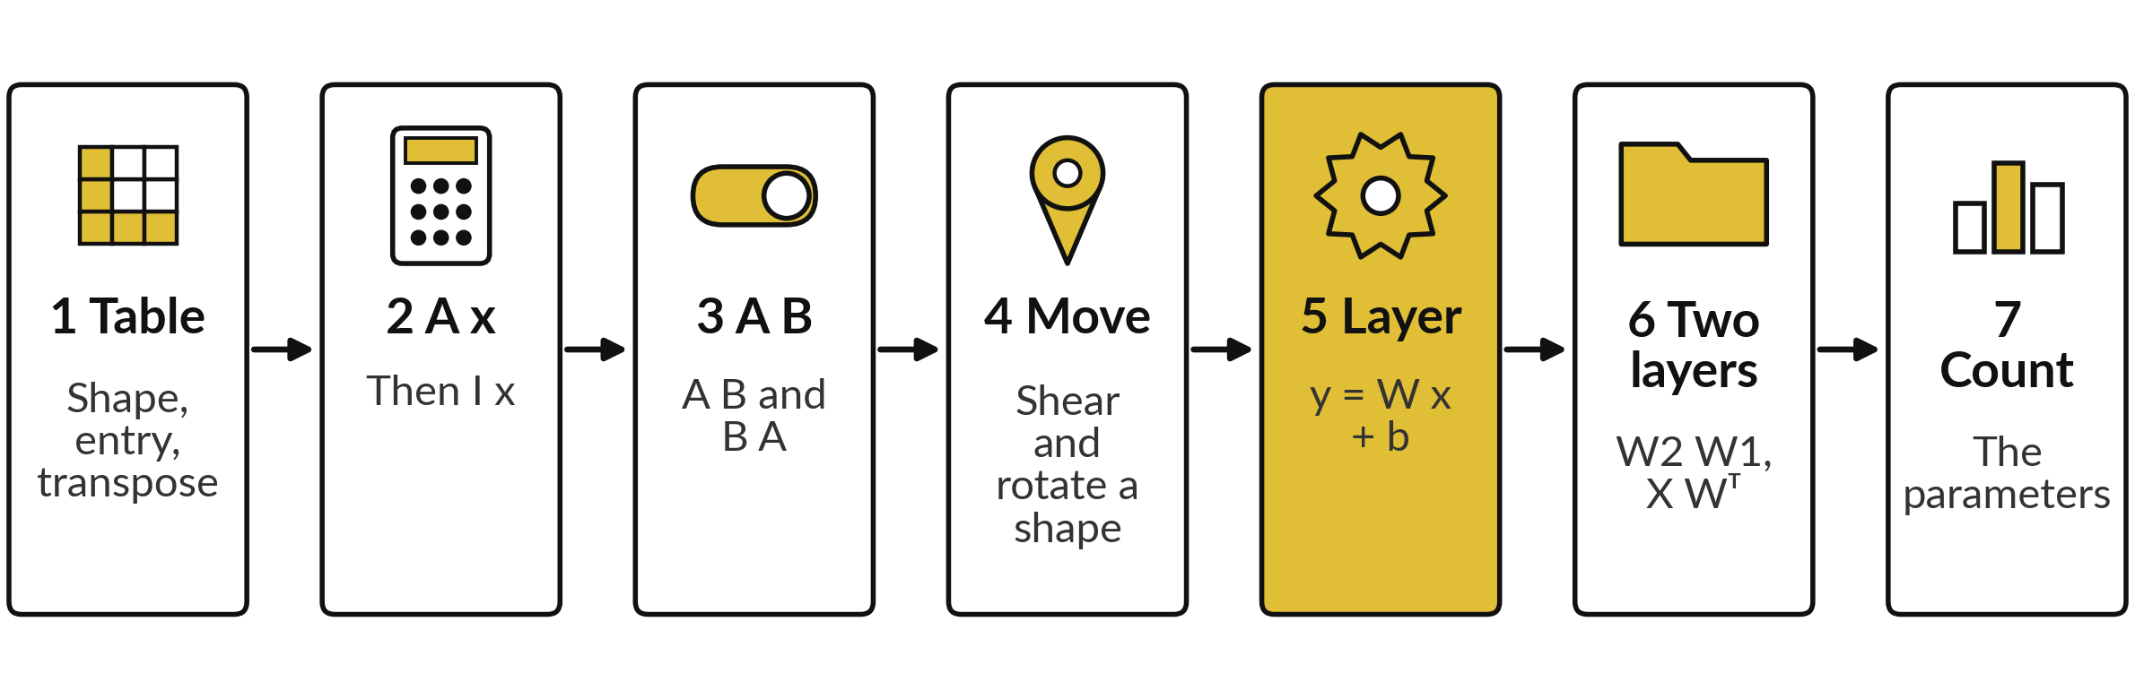
Seven lab steps take you from a
table to a count of parameters
Predict, run, read, change one thing. Workbook: Steps 1 to 4 on Products, 5 to 7 on Layers.
Notes:
The lab has seven steps, the same in the notebook and the workbook. Step one is the learner table, its shape, one entry and the transpose. Step two multiplies A by x and checks that the identity changes nothing. Step three multiplies A by B, and B by A.
Step four moves the L-shaped drawing with a shear and a rotation. Step five computes the layer y equals W x plus b. Step six adds a second layer, and runs a batch of inputs as rows. Step seven counts parameters. In every step predict first, run, read, then change one thing.

Slide 32








Check your numbers before you move on
What you compute | You should get
Learner table: shape, and entry in row 2, column 3 | 3 × 3 and 58
Shape of the transpose of A (2 × 3) | 3 × 2
A x for x = (1, 2, 3) | (14, 32)
A B, rows 1 and 2; shape of B A | (58, 64), (139, 154); 3 × 3
Shear moves the corner (1, 3) to | (4, 3)
Layer 1: y1 = W1 x + b1 | (7.5, −1, 3, 4.5)
Layer 2: W2 y1 + b2 | (10.5, 9)
Parameters: toy network; 1,000 × 1,000 layer | 26; 1,001,000
If your number differs, find the step that went wrong. Do not change a number to match.
Notes:
Use this table as your checkpoint. If your numbers match, carry on. If one does not, call me, because the later steps use the earlier ones. The usual causes are a cell run out of order, using the star instead of the at sign, or forgetting to add the bias.
Do not change a number to make it match. Find out why it is different.

Slide 33




Four messages you may meet,
what they mean and what to do
What you see | What it means | What to do
ValueError: matmul mismatch in the core dimension | The inner numbers of the shapes differ. | Print A.shape and B.shape. They must match inside.
A * B gives an error or the wrong table | The star multiplies entry by entry. | Use A @ B for the matrix product.
#VALUE! or only one cell filled in a spreadsheet | The formula was not an array over the whole answer range. | Excel: select the gold range, type, press Ctrl Shift Enter. Google Sheets: the same keys in the first cell.
IndexError for entry 2, 3 | Python counts from 0, so row 2 and column 3 is entry 1, 2. | Subtract 1 from the row and the column number.
Notes:
Four messages you may meet. A mismatch in the core dimension means the inner numbers of the shapes differ, so print the shapes. The star gives the wrong table, because it multiplies entry by entry. In a spreadsheet, a matrix product fills a whole range, and Control Shift Enter makes sure it does in both Excel and Google Sheets.
And an index error comes from Python counting from zero. Read the message first. It usually tells you the answer.

Slide 34
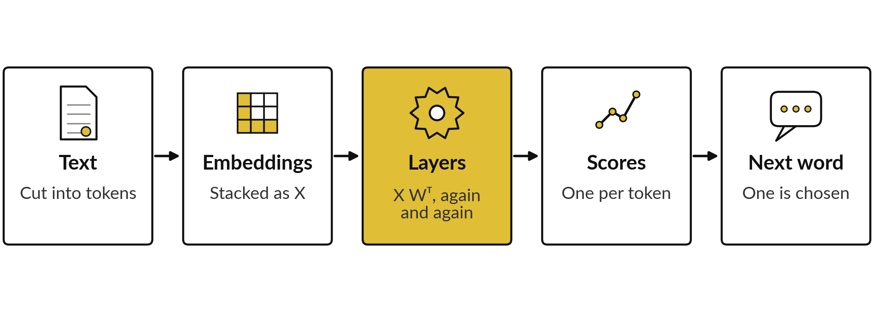
Where this appears in AI: most of the
arithmetic in each layer is matrix multiplication
Published transformer design (Vaswani et al., 2017): most arithmetic is matrix products.
Notes:
Language models of this kind are transformers, a design published in 2017. Text is cut into tokens, each token becomes a vector, and the vectors for a whole text are stacked into a matrix. The published design then multiplies that matrix by weight matrices, layer after layer. Softmax, normalisation and other steps also appear, but most of the arithmetic is matrix products, and attention is built from them.
At the end, the model produces a score for each possible next token. I cannot tell you how a specific product is built inside, because that is not published. But the mathematics you did today is the core of the published design, and the gold step is the one in your lab.

Slide 35
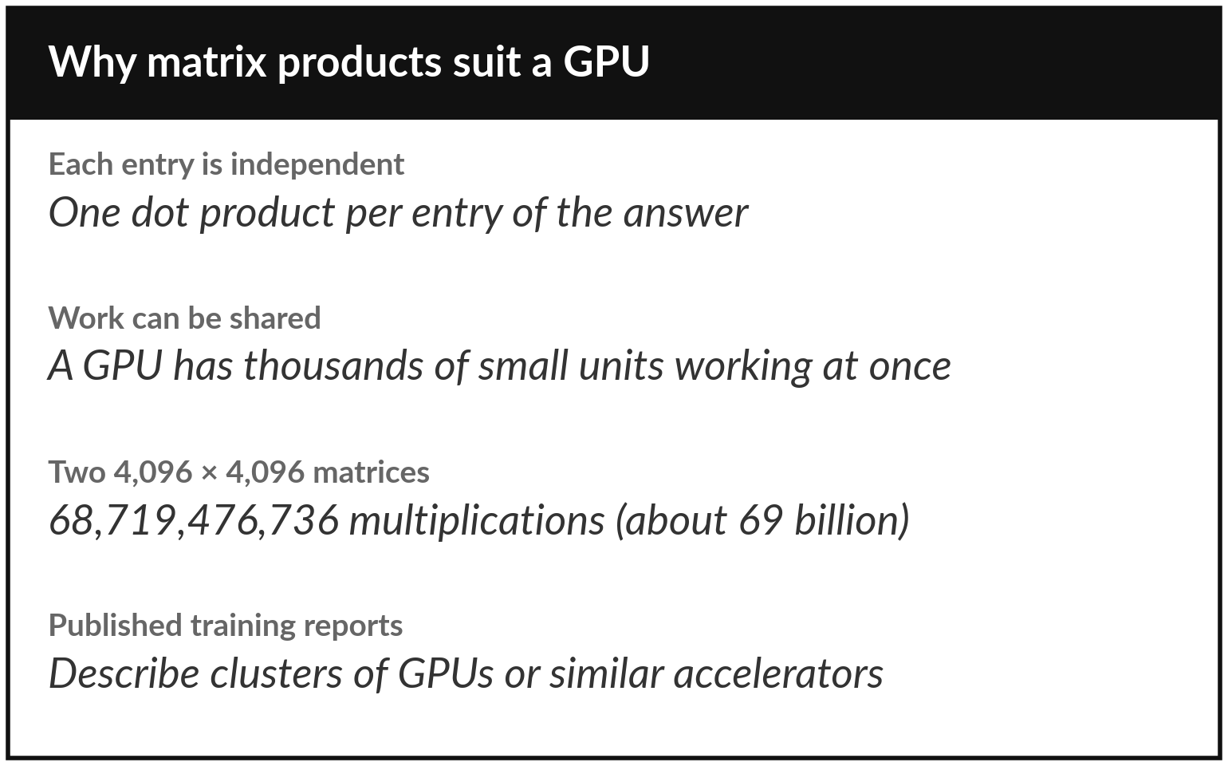
Where this appears in AI: why
graphics processors (GPUs) run models
A GPU (graphics processing unit) was first made to draw images, which needs many simple products.
m × n × p multiplications grow fast with size.
Many dot products at once suit a GPU.
Training and running large models need fast matrix products.
Notes:
Why are graphics processors, or GPUs, used for AI?
Remember the count from earlier: a matrix product needs m times n times p multiplications. Two matrices of size four thousand ninety-six need 68,719,476,736 of them, about sixty-nine billion. But every entry of the answer is an independent dot product. So the work can be shared out. A GPU has thousands of small arithmetic units that work at the same time.
It was first built to draw images, which also needs vast numbers of simple products. That match is why training and running large models depend on GPUs. Hardware details of specific products are not something I will claim.

Slide 36
Where this appears in AI: check
an assistant with your numbers
8 minutes
Hands-on activity
Ask an AI assistant to multiply our two matrices.
You keep
A note: the assistant answers, your lab numbers, and whether they agree.
Give it A with rows (1, 2, 3), (4, 5, 6) and B with rows (7, 8), (9, 10), (11, 12). Ask for A B.
Compare: rows (58, 64) and (139, 154).
Ask for the parameters of a 1,000 by 1,000 layer: expect 1,001,000.
Notes:
A short activity. Open any AI assistant and give it our two matrices, A and B, and ask it for the product A times B. Compare with your lab: fifty-eight, sixty-four, one thirty-nine, one fifty-four. Then ask how many parameters a layer has with a thousand inputs and a thousand outputs, with biases.
The answer should be one million one thousand. Did it get both right?
Did it show its steps?
Never paste confidential data into an assistant. These numbers are public maths, so they are safe. Note what you found for the exit check.

Slide 37


Exit check: three questions, then
compare with the short answers
Question | Short answer
Can a 3 × 4 matrix multiply a 4 × 2 matrix? If yes, what is the shape of the answer? | Yes. The inner numbers are 4 and 4. The answer is 3 × 2.
What is (1, 2; 3, 4) times the vector (1, 1)? Write the matrix as rows (1, 2) and (3, 4). | Row 1: 1 + 2 = 3. Row 2: 3 + 4 = 7. The answer is (3, 7).
How many parameters does a layer have with 10 inputs and 5 outputs, with biases? | 5 × 10 + 5 = 55.
Notes:
Last, the exit check. Write your answers in your notes first. One, can a three by four matrix multiply a four by two matrix, and what is the shape of the answer?
Two, take the matrix with rows one two and three four, and multiply it by the vector one one. Three, how many parameters does a layer have with ten inputs and five outputs, with biases?
The short answers are on the slide. If you got all three, you are ready for solving linear systems next session. If one surprised you, look at that part of the lab again tonight.

Slide 38
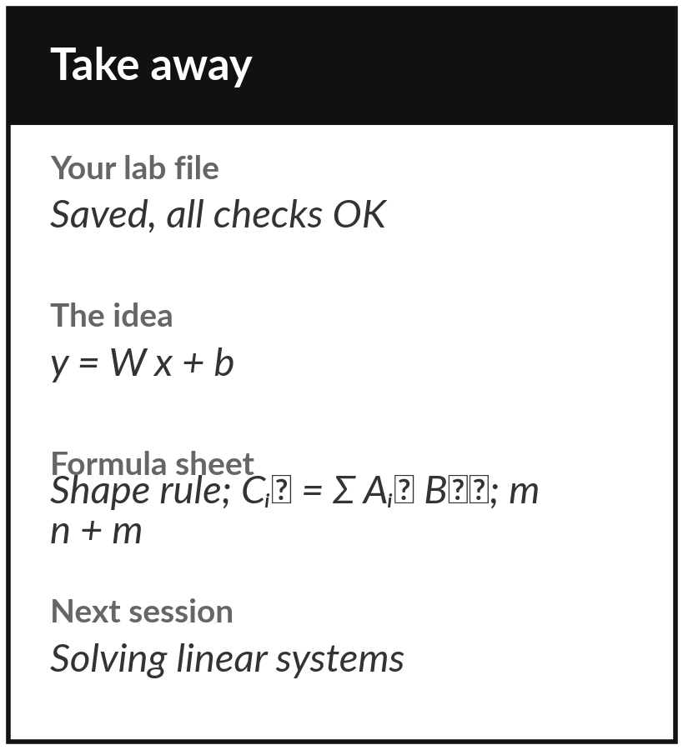
Save your lab file and add
three rules to your sheet
What you keep from today
Keep your saved notebook or workbook, with every check on OK. Keep the idea of the day: a layer is y = W x + b, and the parameters of a model are the numbers in its matrices and biases.
Our question today
A language model has billions of parameters. What are those numbers, and what does the model do with them?
Next session
Session 4: Solving linear systems. We write equations as a matrix, and meet the inverse, the determinant and the rank.
Notes:
Before you go, save your notebook or workbook with every check on OK. Add three rules to your one-page sheet: the shape rule for multiplying matrices, the matrix product as a sum of products, and the parameter count of a layer, m times n plus m. Next session we use matrices to solve systems of equations, and we meet the inverse, the determinant and the rank. Write down any question that you still have and bring it.
We began with this question: A language model has billions of parameters. What are those numbers, and what does the model do with them? Before you go, say in one sentence what you can now say about it.

